Slide 1
Community Preference Aggregation
Marcus Echols
Will Doucet
Chetan Balachandra

Slide 2
Goal Statement
-Find and visualize data on factors people consider when looking for a place to live
-Aggregate various preferences to suggest ideal counties to live in.

Slide 3
Data Sources
US Census (American Community Survey):
-Income, Commute Time, Mortgage Payment, Rent Payment
Zillow:
Median Home Value

Slide 4
Challenges
Data Collection
Determining what data is available
Learning how to build api queries and configure wrappers
Changing scope or direction of project as data is acquired, organized, and visualized

Slide 5
Preference Aggregation/Analysis
Different Types of Data: continuous vs. discrete, ranks vs. scores, categorical vs. ordinal…
Had to manipulate raw data with various equations and categorization procedures so that it could be aggregated and ranked.
Difficult Examples: mortgage / monthly rent (custom range), crime/age distribution (low score vs. high score preferable), highly individualized preferences (school size, community amenities, etc…)

Slide 6
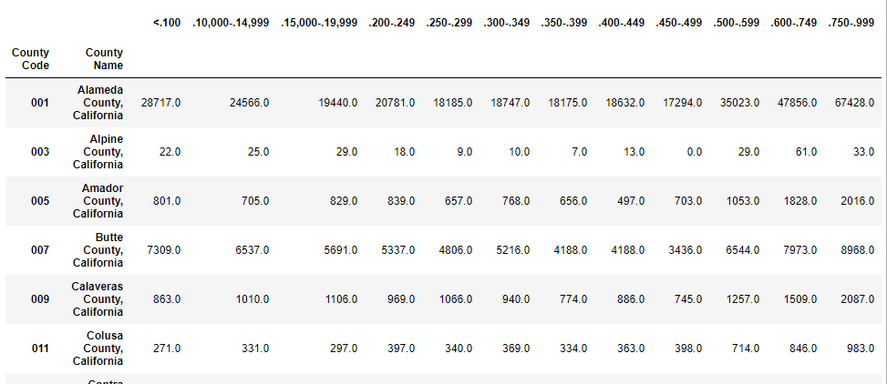

Slide 7
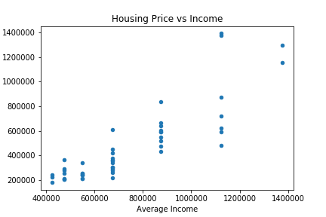

Slide 8
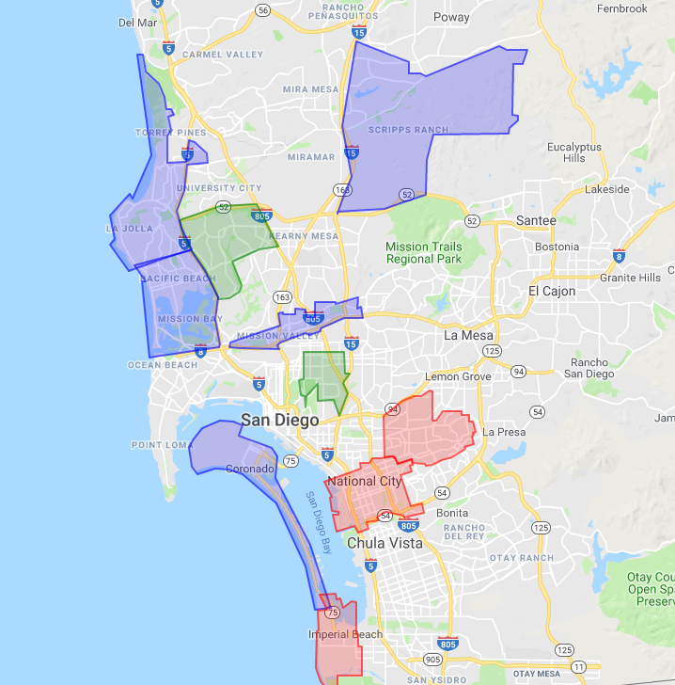

Slide 9
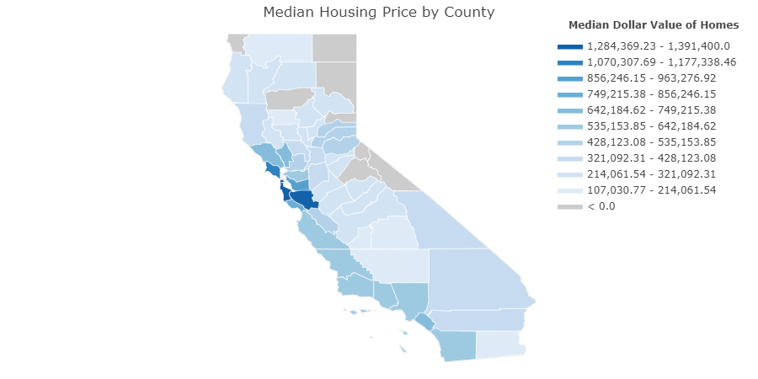

Slide 10
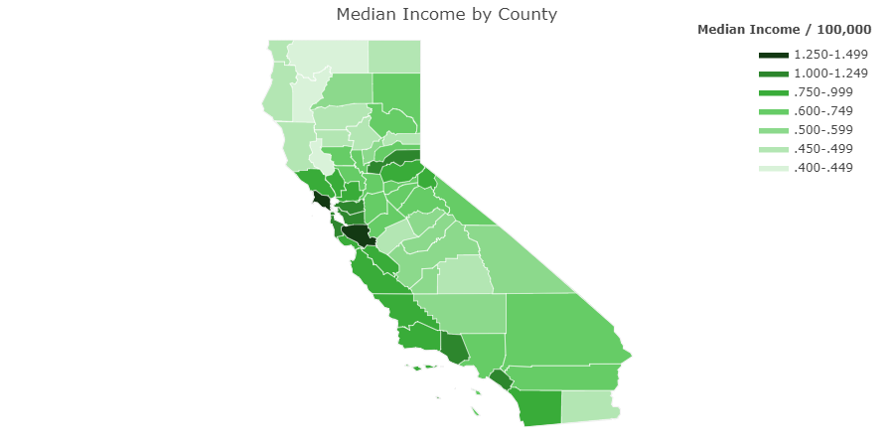

Slide 11
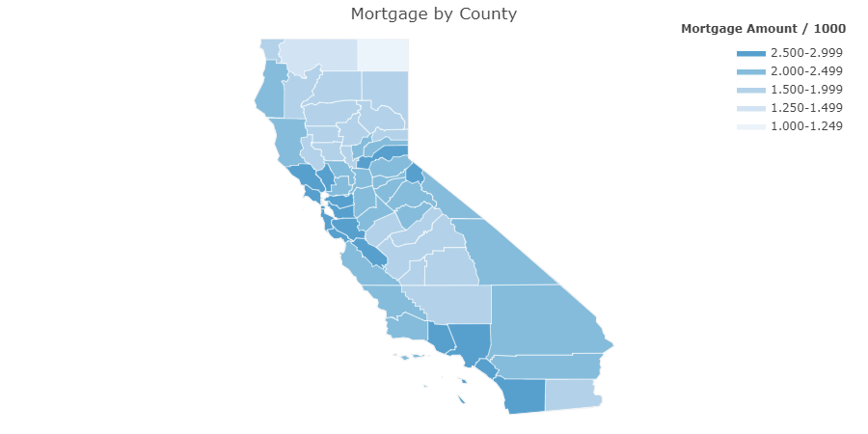

Slide 12
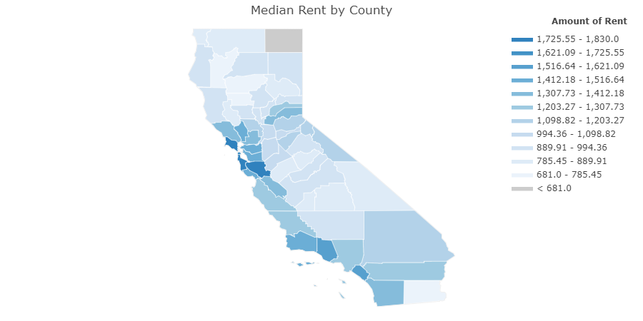

Slide 13
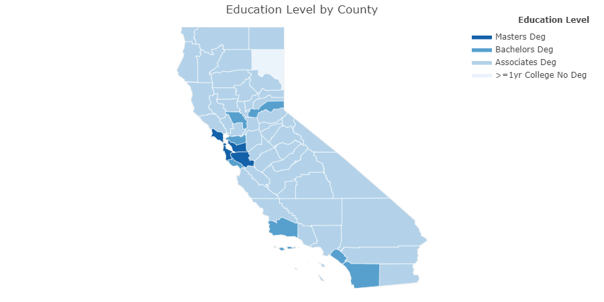

Slide 14
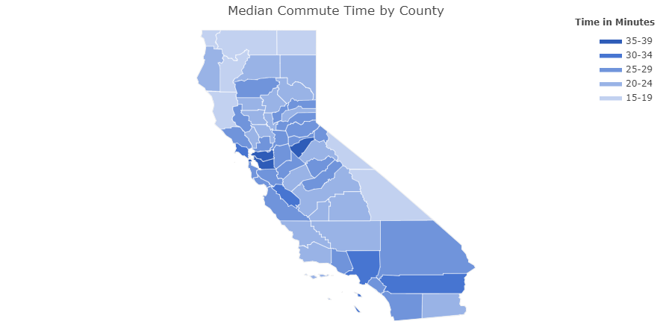

Slide 15
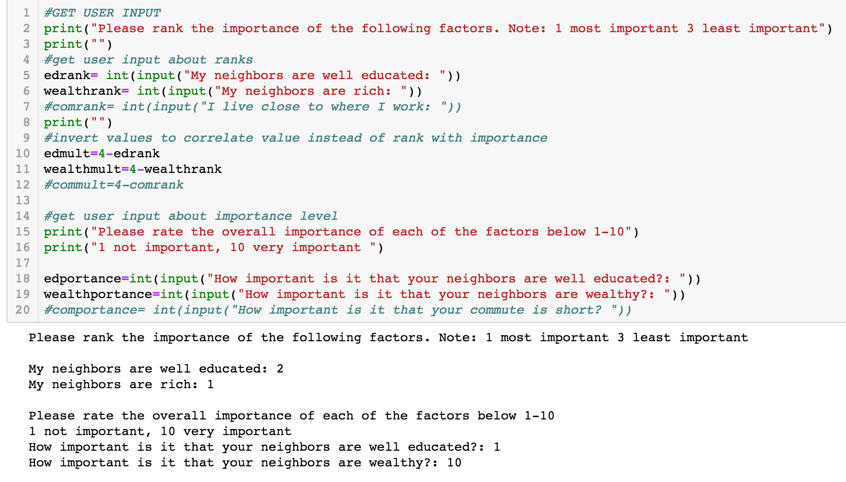

Slide 16
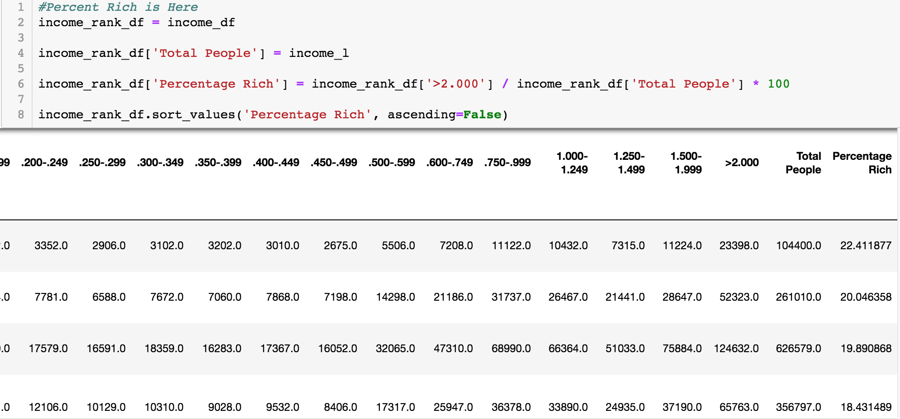

Slide 17
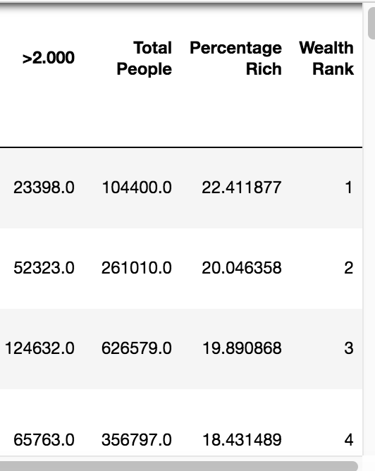

Slide 18
Preference Aggregation Explanation
Under the time constraint of the project, we used income and education level information, but set up the algorithm to make it easy to add more factors later.
Definitions Used: “Rich” = $200k/yr income. “Educated” = BA or higher.
Mathematical/Logical Considerations:
Convert Rank to Score: score = len(data)-rank
Types of Opinion: Comparative (A is better than B), Intensity (how (adjective) on a scale of 1-10?)
Relationship of Variables: Independent or Associated, i.e. sum or product.

Slide 19
Preference Aggregation Final Formula
Variables:
Education Score (of city) (E), Wealth Score (of city) (W) ⇒ Independent
Education Importance (e), Wealth Importance (w) ⇒ Independent
But… Education Score & Education Importance ⇒ Dependent
“ ” Wealth Score & Wealth Importance ⇒ Dependent
Final City Score = Ee + Ww

Slide 20
Preference Aggregation Problems / Future Hopes
Mapping Psychology to Mathematics: choices of scales (more options than 1-10), compatibility of measurement approaches, varying extent of quantifiability of mental states.
In order to address the variety of concerns for users choosing a county to live in, we would need to be able to accommodate a larger variety of real life preferences represented by different data types (give examples).
Illogical responses, e.g. higher rank with lower importance. (should add try/catch block)

Slide 21
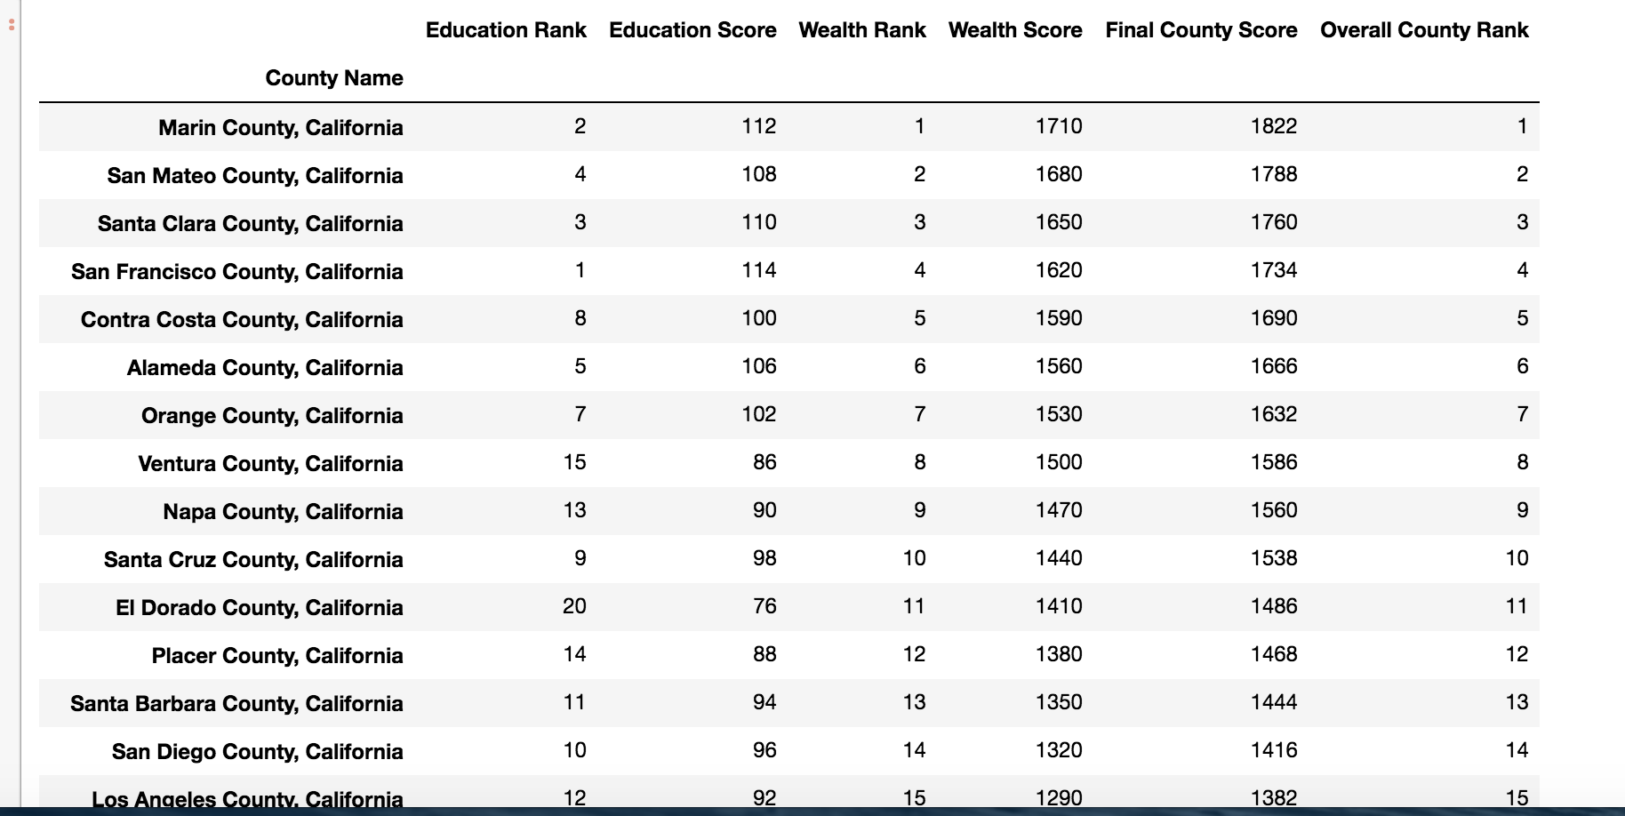

Slide 22
Conclusions
Wealth, Income, Education all tend to be highest in the big cities or the areas around them
Home prices tend to be highest in coastal california
Education and Wealth are usually strongly correlated, but there are some exceptions in more rural counties with high home values.
Exploration of the data through user input can yield a variety of personally relevant conclusions.

Slide 23
Improvements
Use of historical data to visualize trends over time
Better data would provide a more detailed understanding of what we’re trying to show
For a county with a median commute time of 30-35 minutes how much of that is caused by traffic
When looking at mortgage payment relative to value of the house, info on the time the houses were built and if the original homebuyer was still living there would better explain trends

